Slide 1
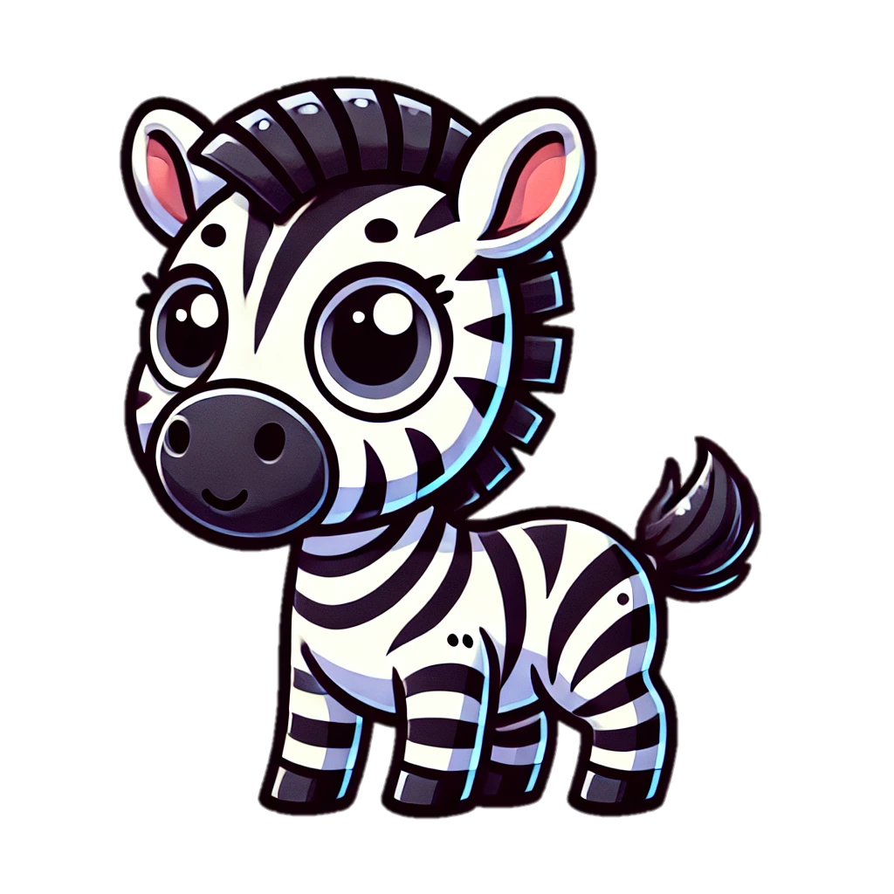

Alphabet
Livre de Coloriage
Aa Bb Cc Dd Ee Ff Gg

Slide 2


Aa
Tracer & Colorer
Alphabet

Slide 3


Tracer & Colorer
Bb
Alphabet

Slide 4


Cc
Tracer & Colorer
Alphabet

Slide 5


Dd
Tracer & Colorer
Alphabet

Slide 6

Ee
Tracer & Colorer
Alphabet

Slide 7


Ff
Tracer & Colorer
Alphabet

Slide 8


Gg
Tracer & Colorer
Alphabet

Slide 9
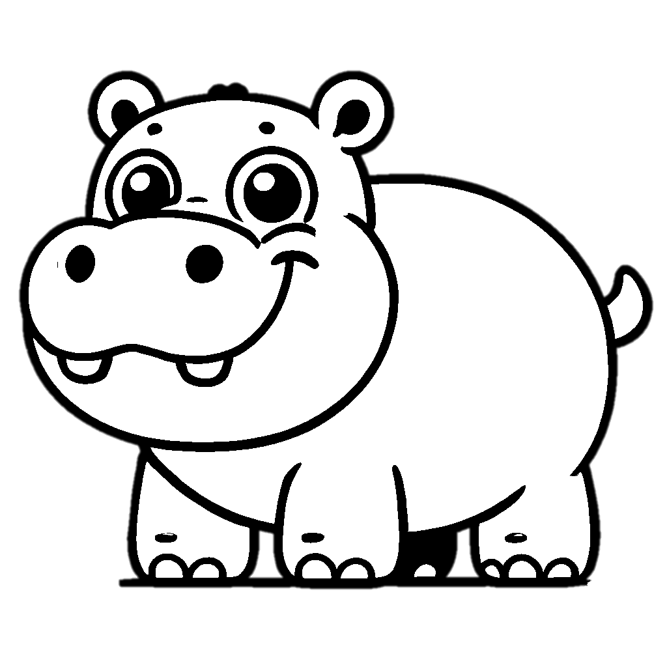

Hh
Tracer & Colorer
Alphabet

Slide 10
I i
Tracer & Colorer
Alphabet

Slide 11


Jj
Tracer & Colorer
Alphabet

Slide 12


Kk
Tracer & Colorer
Alphabet

Slide 13


Ll
Tracer & Colorer
Alphabet

Slide 14


Mm
Tracer & Colorer
Alphabet

Slide 15


Nn
Tracer & Colorer
Alphabet

Slide 16


Oo
Tracer & Colorer
Alphabet

Slide 17


Pp
Tracer & Colorer
Alphabet

Slide 18
Qq
Tracer & Colorer
Alphabet
4
4

Slide 19


Rr
Tracer & Colorer
Alphabet

Slide 20


Ss
Tracer & Colorer
Alphabet

Slide 21


Tt
Tracer & Colorer
Alphabet

Slide 22


Uu
Tracer & Colorer
Alphabet

Slide 23


Vv
Tracer & Colorer
Alphabet

Slide 24


Ww
Tracer & Colorer
Alphabet

Slide 25
Xx
Tracer & Colorer
Alphabet

Slide 26
Yy
Tracer & Colorer
Alphabet

Slide 27
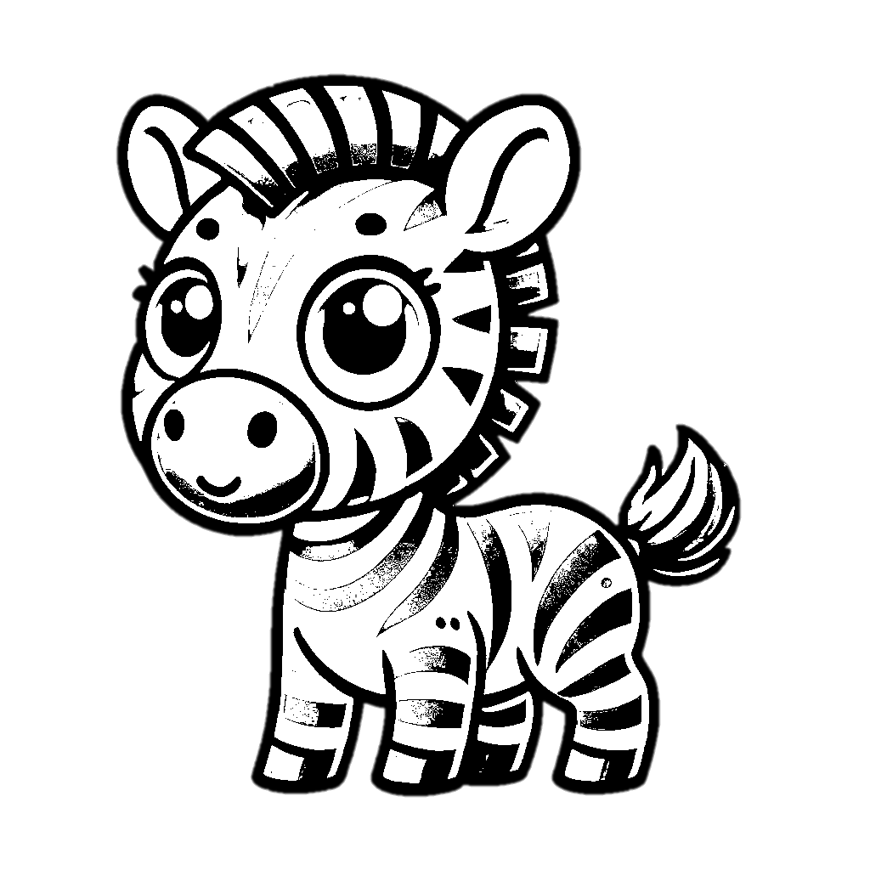
Z z
Tracer & Colorer
Alphabet

